Slide 1
Digital Asset Custody Service
: Project Progress Report
Haechan Lee
Nguyen, Van Tu
Minji Choi
Jeongheon Kim

Slide 2
Project Overview
Digital Asset Custody Service (DACS)
Keep users private digital asset (Cryptocurrency, NFT) safely
Digital asset’s ownership can be proved by only the owner’s private key
Two kinds of DACS
Digital asset consignment management service
Private key management service
In this project
Implement digital asset consignment management service using Multi-party computation (MPC)
Implement private key management service using Multi-sig

Slide 3
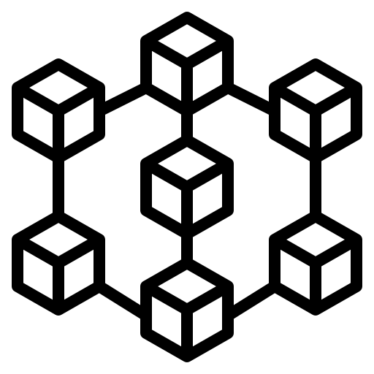
Architecture
Customer
Customer
Customer
Customer
Customer
User Wallet – Web (Front-End)
API
API
API
API
API
Multi-sig Smart Contract
Intermediary Server (Back-End)
User Backup Key Storage
Key Storage
Key Storage
Key Storage
Cold Wallet
Cold Wallet
Cold Wallet
Blockchain Node
Cold Wallet for Multi-sig
MPC-based Key Management System
MPC-based Key Management System
MPC-based Key Management System
Service Provider

Slide 4
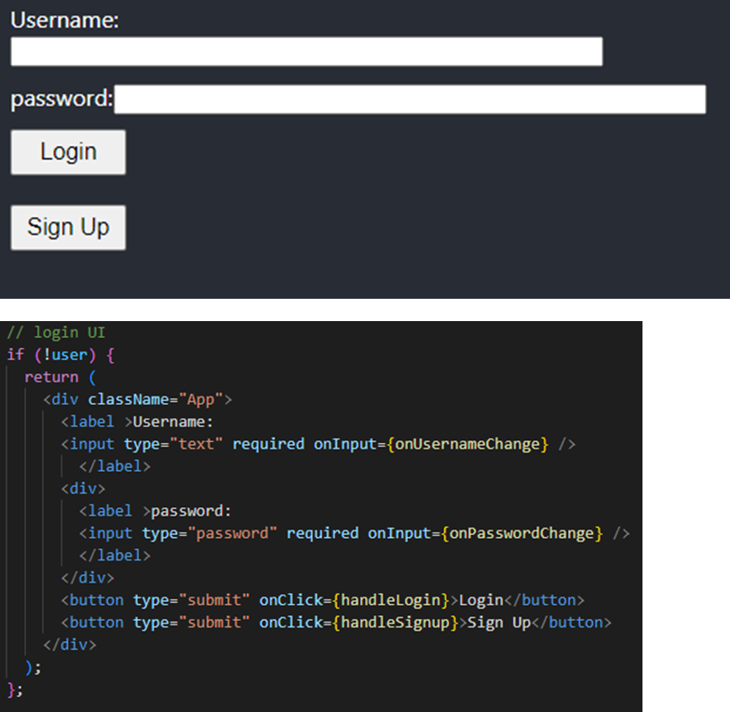
User GUI (frontend, 1/2)
Front-end wallet for user
Implemented with Node.js and React.
Features
Sign Up : Enroll Username and Password for using the wallet.
Login : Connect to the server using the previously registered account and password.

Slide 5
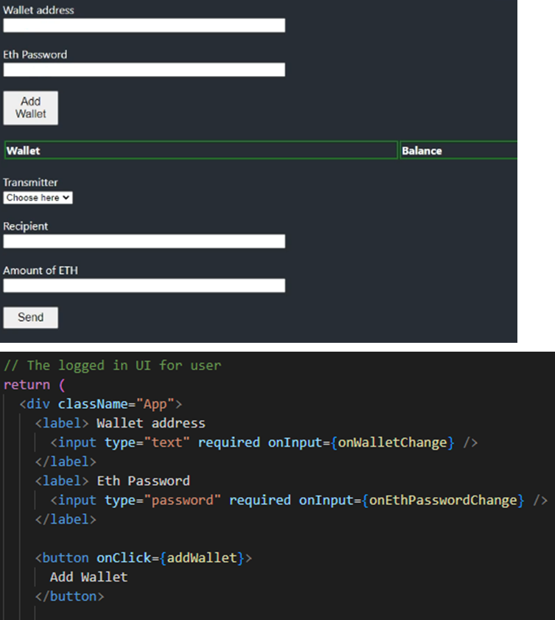
User GUI (frontend, 2/2)
Front-end wallet for user
Implemented with Node.js and React.
Features
Add Wallet: allow user to add their User’s Ethereum wallet address and password.
Send ETH: Send ETH to other Ethereum Account (not implemented yet)

Slide 6
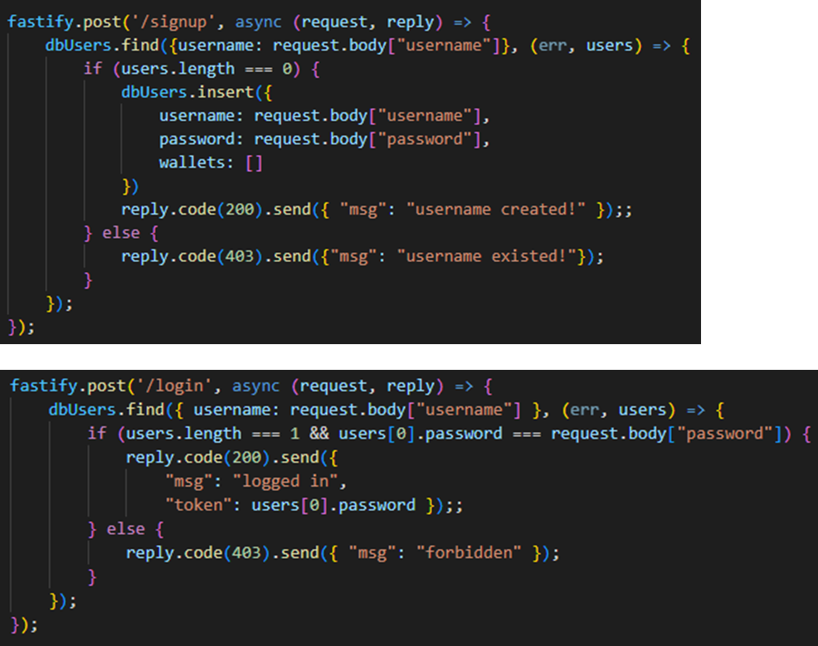
Server side (backend, 1/3)
Manage user information and transactions
Provides REST APIs
Implemented using Fastify (node.js) and web3
APIs
Signup: Get user’s input of username and password then record it to database file
Login: Check whether username and password matches correctly, then reply front-end

Slide 7
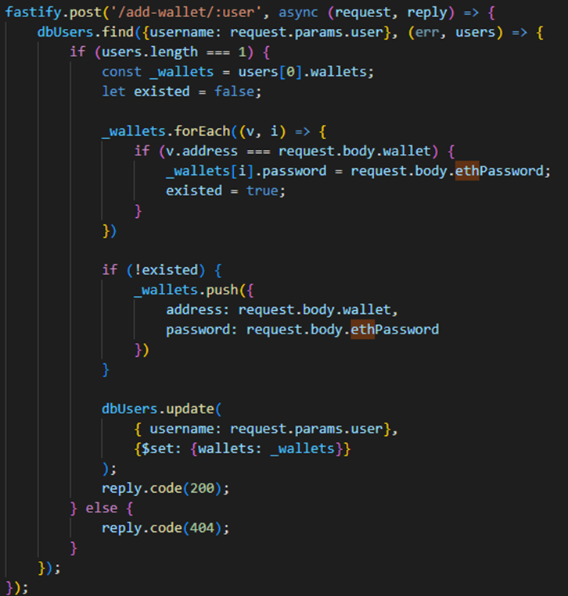
Server side (backend, 2/3)
Handle transactions and managements
Provides REST APIs
Implemented using Fastify (node.js) and web3
APIs
Add wallet: allow user to add new wallet with password

Slide 8
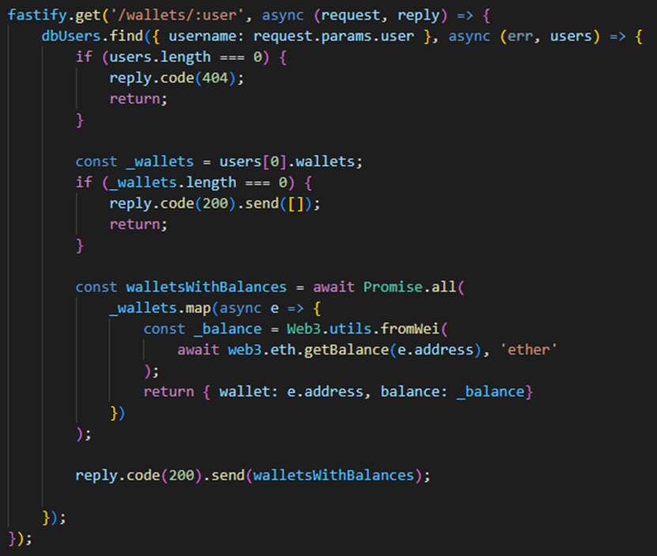
Server side (backend, 3/3)
Handle transactions and managements
Provides REST APIs
Implemented using Fastify (node.js) and web3
APIs
Get wallet: Get wallets of an user and return the wallet address with balances
Send: (not implemented yet, need to integrate with MPC & multisig)

Slide 9
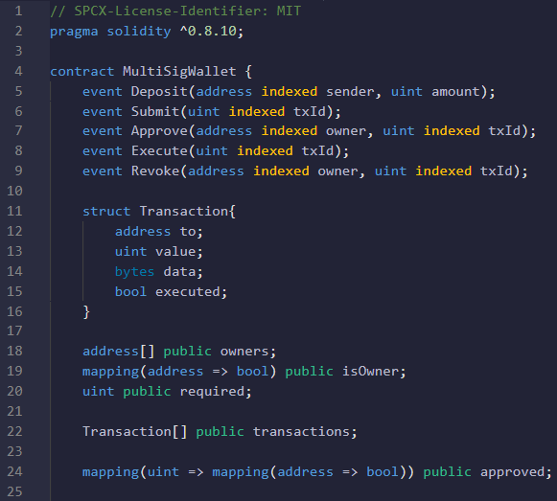
Multi-Signature Smart Contract (1/5)
Event
Deposit : Deposit ETH in Multisig wallet
Submit : Submit transaction, waiting for approval
Approve : Owners approve transactions
Execute : Implement transactions
when certain amount of approvals exists
Revoke : Owners can revoke approvals
before implementing transaction
Transaction Structure
Address, value, data, execution
Define public address & values
Address of Owners
Value of required
Array of Transactions
Boolean of Approved

Slide 10
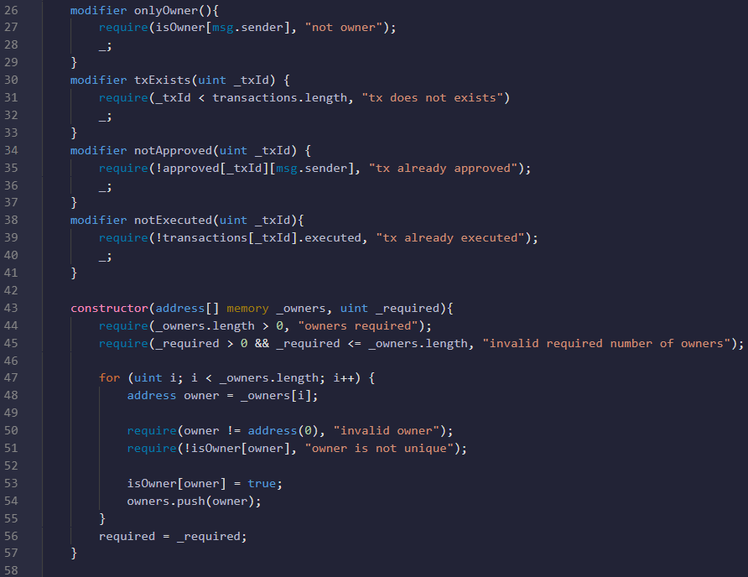
Multi-Signature Smart Contract (2/5)
Modifier for functions
onlyOwner : Check if the address is owner
txExists : Check if the transaction exists
notApproved : Check transaction if it is
approved or not
notExecuted : Check transaction if it is
executed or not.
Constructor
# of owner has to be more than one.
‘required’ value should be more than zero,
less than # of owner.

Slide 11
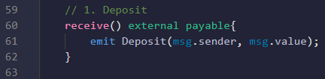
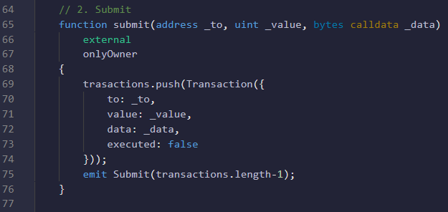
Multi-Signature Smart Contract (3/5)
Event1. Deposit
Make Multisig wallet able to receive ETH.
Event2. Submit
Only owner can submit transaction
When the transaction is submitted,
and the transaction has received
sufficient amount of approvals,
the owner can execute transaction.

Slide 12
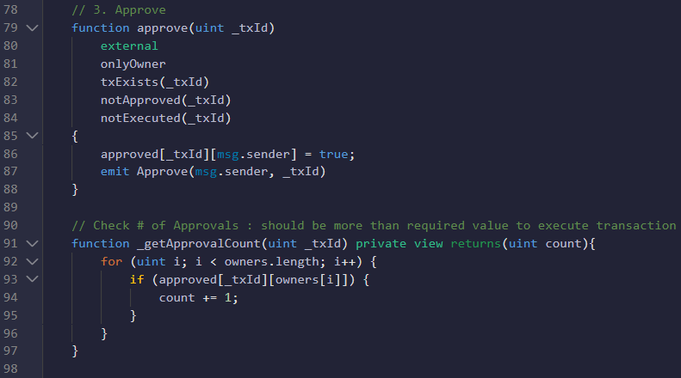
Multi-Signature Smart Contract (4/5)
Event3. Approve
After the transaction is submitted,
other owners can approve the transaction

Slide 13
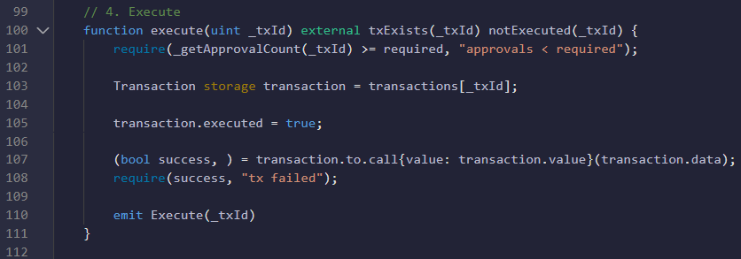
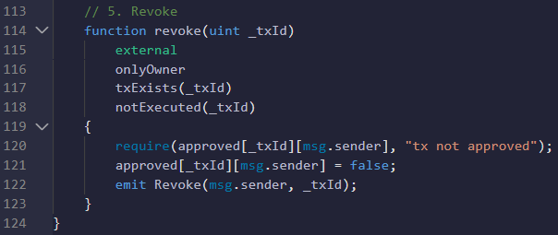
Multi-Signature Smart Contract (5/5)
Event4. Execute
When the number of approval
is more than required value,
the transaction can be executed
Event5. Revoke
Even if the owner had approved the transaction,
the owner can revoke the transaction
before the transaction is executed

Slide 14
MPC (1/4)
Select MPC protocol
GG20¹ - Full Threshold (t,n) ECDSA protocol
https://github.com/ZenGo-X/multi-party-ecdsa/tree/master/src/protocols/multi_party_ecdsa/gg_2020
MPC can be divided to two process
Key generation protocol
Generate the share of private key, public key
The public key should be translated to Ethereum address
Signing protocol
Generate the ECDSA signature (r,s) by signing the hash of unsigned transaction
Then by sending ECDSA signature, the unsigned transaction could be signed and send
[1] GENNARO, Rosario; GOLDFEDER, Steven. One round threshold ECDSA with identifiable abort. Cryptology ePrint Archive, 2020.

Slide 15
MPC (2/4)
Key generation
Save share of private key in local-share.json
Output the ECDSA public key K = (x,y)
Ethereum public key translation
“04 | x | y” by Standard for Efficient Cryptography (SEC1)
ex) “04d604f22b8f063a5091027f4a63937cc0131a2ef369fdfb4d6a129b63af7d507a20efd3231d0eb3aeda4e96162ea4557cec481a050cfb8dc90d9e6633a877787c”
Ethereum address translation (Public Key -> Address)
“(keccak-256(x | y))[-20:]”

Slide 16
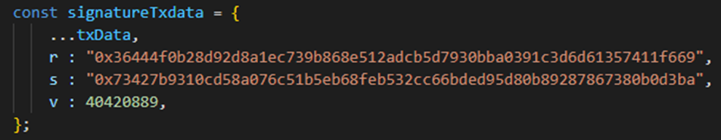
MPC (3/4)
Signing
Generate the ECDSA signature (r,s) and recid value by signing hashed unsigend transaction
Using recid value and Etheruem network id, it can calculate v
Send the r, s, v to unsigned transaction

Slide 17
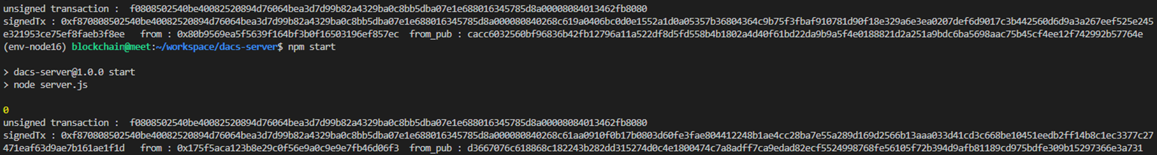
MPC - troubleshooting (4/4)
Trouble 1
By extracting sender address in signed transaction, it’s different with our address
Our ethereum address : “0x28b3FCEdBb5168452374eB58F957d62be223381F”
Extracted sender address : “0xf45b2b9c6455c6dd1cfc968e2b8d1a7a46b66f6a”
Trouble 2
If I create another signature of same transaction (r, s is different), then the server shows different sender address every time.

Slide 18
Finish

